Slide 1

Report on
Business Analytics Capstone Project
(Using R)
Domain – Heathcare
Project ID : CP1
Gaikwad Ganesh B.
Submitted on Date:
16/02/2019
Mentor : Govinda Bobade

Slide 2
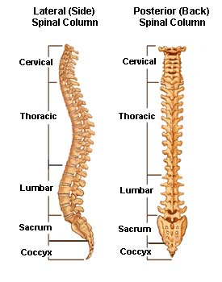
BUSINESS ANALYTICS CAPSTONE PROJECT REPORT
Analysis of Spinal Cord dataset

Slide 3
Introduction
The dataset contain spinal cord data. The spinal cord is a collection of nerves that travels from the bottom of the brain down your back.
Dimensions of the dataset
variables – 13
observations - 320
The dataset contains the target variable i.e. Status which has two levels, Abnormal and normal

Slide 4
Objective of the study
To predict whether patients have a lower back problem or the symptoms could be indications of some other problem.

Slide 5
Import the data in R Studio. Summary of data was taken where we get detailed information about the data. According to the summary there have no missing values (NA) so we can go further. The next step is to check the outlier in certain attribute for this purpose, box plot was used. If there are outliers, the outliers are capped by replacing them with the quantile values. After capping the outliers, the correlation between the variables is represented by corrplot plot.
BUSINESS ANALYTICS CAPSTONE PROJECT REPORT
1.3 Approach of the Study

Slide 6
the dataset was divided randomly into 70% Training and 30% Testing. logistic regression model was applied on training dataset remove the insignificant variable and also the variable which has high multicolinearity. Made prediction on training data set, and check the accuracy of the model using confusion matrix. Apply the model on test data set. Plot the ROC curve.
BUSINESS ANALYTICS CAPSTONE PROJECT REPORT

Slide 7

BUSINESS ANALYTICS CAPSTONE PROJECT REPORT
2. DATA EXPLORATION

Slide 8
Variable identification: The dataset contains twelve predictors and one response. The response contain two levels i.e. Abnormal and Normal
Univariate Analysis
Continuous variables – observations within each variable are normally distributed. Using boxplot we see that among All predictors few of them contains outliers.
Categorical variables - for categorical variable frequency table shows the distribution of each category.
Bivariate Analysis: Bivariate analysis shows the relationship between two variables. By using correlation plot we get degree spondylolisthesis is highly correlated with response as compare to others and pelvic radius is negatively correlated with response.

Slide 9
Variable Creation: The dataset contain one categorical variable, so we created dummy variable for status.
Outlier treatment: Among the all predictors following are contains outliers.
Pelvic incidence
Pelvic tilt
Lumber lordosis angle
Sacral slope
Pelvic radius
Degree spondylolisthesis

Slide 10

BUSINESS ANALYTICS CAPSTONE PROJECT REPORT
3. DATA VISUALISATION

Slide 11
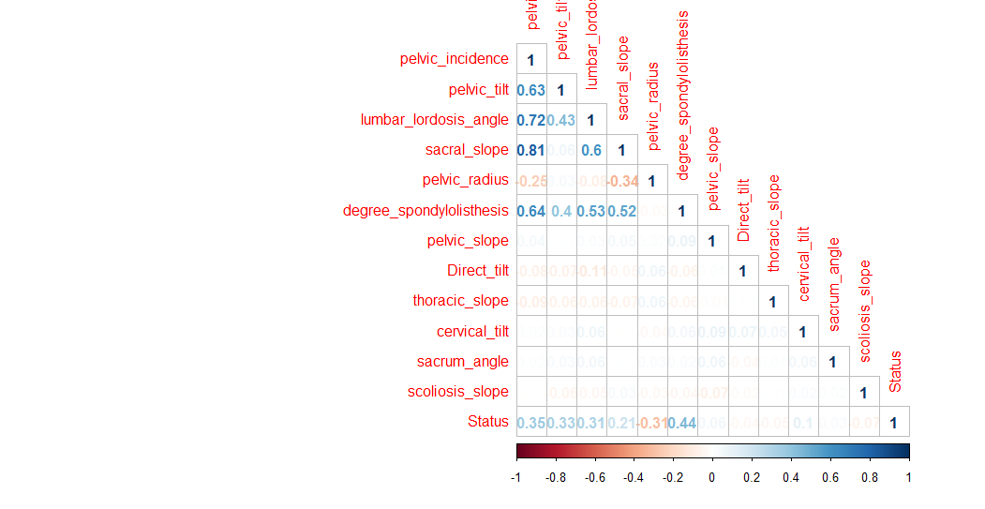
Correlation plot

Slide 12
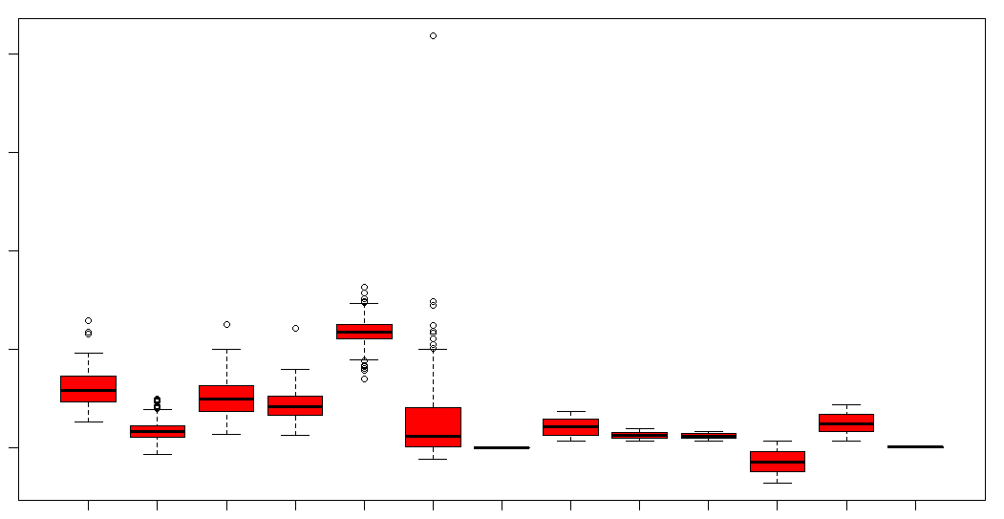
Boxplots before capping outliers

Slide 13
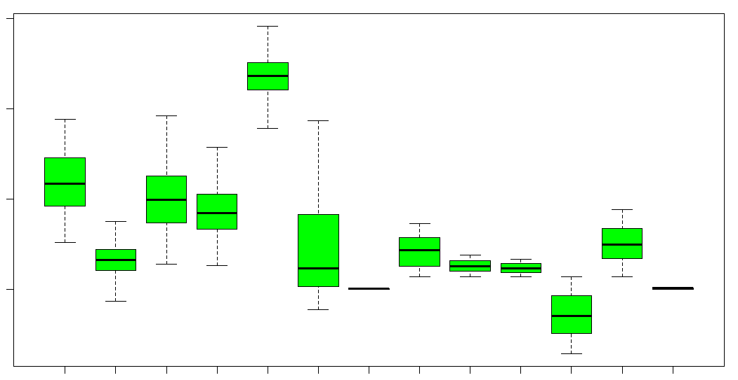
Boxplots After capping outliers

Slide 14
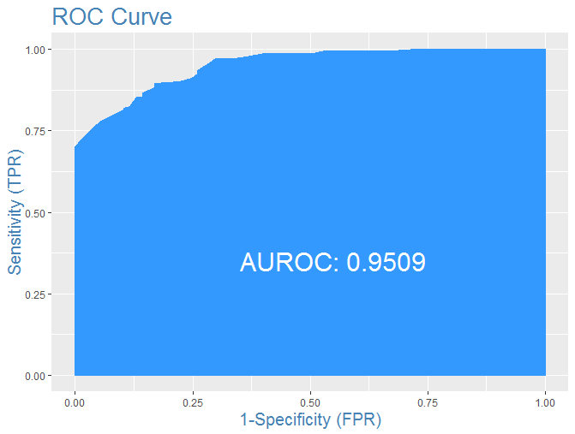
ROC CURVE

Slide 15
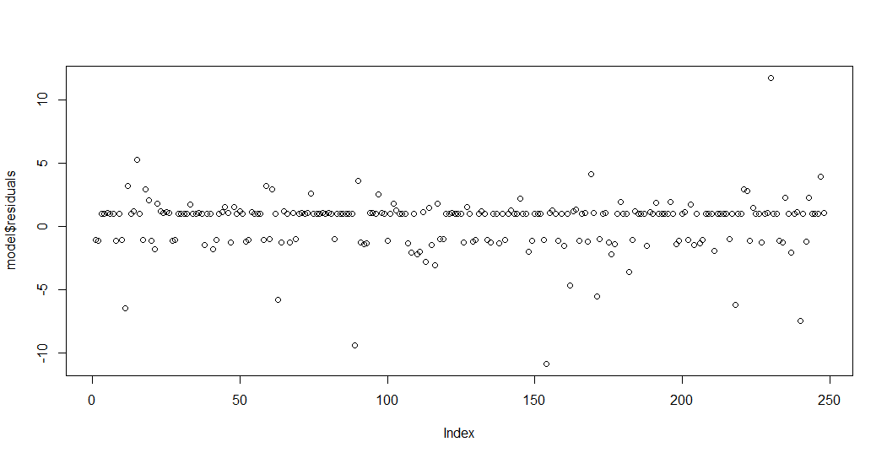
Residual plot

Slide 16
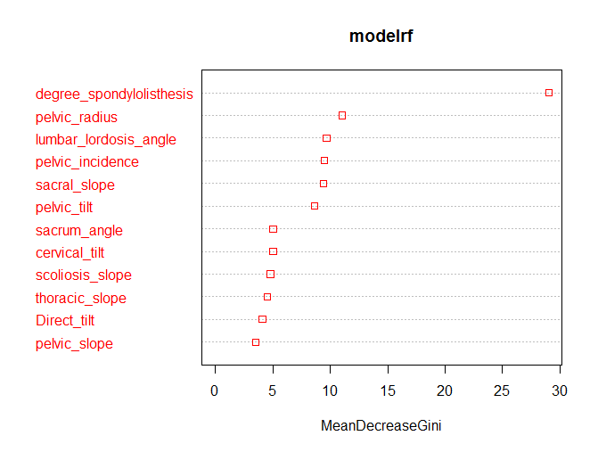
Variable importance plot using random forest

Slide 17

BUSINESS ANALYTICS CAPSTONE PROJECT REPORT
5. DATA MODELLING

Slide 18
Dataset contains categorical response variable so we used classification Algorithm
Logistic regression - target variable is binary
Assumptions :
There should be a linear relationship between dependent (response) variable and independent (predictor) variable.
The target variable is binary or dichotomous variable.
There is no multicolinearity between the predictors.
There is no influential values (outliers) in the continuous predictors.

Slide 19

BUSINESS ANALYTICS CAPSTONE PROJECT REPORT
6. INSIGHTS DERIVED AND RECOMMENDATIONS

Slide 20
Confusion matrix for train data
Accuracy : 0.8468
precision : 0.8735
Recall : 0.8951
AUC (Area under curve) = 0.9509
Reference
Prediction 0 1
0 65 17
1 21 145

Slide 21
Confusion matrix for test data
Accuracy : 0.871
precision : 0.8182
Recall : 0.8523
Reference
Prediction 0 1
0 18 0
1 8 36

Slide 22
Confusion matrix using random forest
For train data
For test data
Reference
Prediction abnormal normal
abnormal 154 24
normal 19 51
Accuracy : 0.8266
Precision : 0.8652
Recall : 0.8902
Reference
Prediction abnormal normal
abnormal 33 7
normal 4 18
Accuracy : 0.8226
Precision : 0.8250
Recall : 0.8919

Slide 23

BUSINESS ANALYTICS CAPSTONE PROJECT REPORT
7. APPENDICES

Slide 24
I. COMPILATION OF R CODE
# import the data
setwd("C:\\Users\\admin\\Desktop\\project")
data <- read.csv("Dataset_spine.csv")
summary(data)
library(corrplot)
# making dummy variable for status
data$Status <- ifelse(data$Status=="Abnormal",1,0)
# correlation plot
cor <- cor(data)
corrplot(cor, method = "number", type = "lower")
#boxplot of whole data with outlier
boxplot(data, col = "red",labels(names(data)))

Slide 25
# outlier capping
bx1 <- boxplot(data$pelvic_incidence)
bx1$stats
quantile(data$pelvic_incidence, seq(0,1,0.02))
data$pelvic_incidence <- ifelse(data$pelvic_incidence>95,90,data$pelvic_incidence)
boxplot(data$pelvic_incidence)
bx2 <- boxplot(data$pelvic_tilt)
bx2$stats
quantile(data$pelvic_tilt, seq(0,1,0.02))
data$pelvic_tilt <- ifelse(data$pelvic_tilt>38,36, data$pelvic_tilt)
bx3 <- boxplot(data$lumbar_lordosis_angle)
bx3$stats
quantile(data$lumbar_lordosis_angle, seq(0,1,0.02))
data$lumbar_lordosis_angle <- ifelse(data$lumbar_lordosis_angle>100,93, data$lumbar_lordosis_angle)
bx4 <- boxplot(data$sacral_slope)
bx4$stats
quantile(data$sacral_slope, seq(0,1,0.02))
data$sacral_slope <- ifelse(data$sacral_slope>79,69, data$sacral_slope)

Slide 26
bx5 <- boxplot(data$pelvic_radius)
bx5$stats
quantile(data$pelvic_radius, seq(0,1,0.02))
data$pelvic_radius <- ifelse(data$pelvic_radius<89,90, data$pelvic_radius)
data$pelvic_radius <- ifelse(data$pelvic_radius>146,145, data$pelvic_radius)
bx6 <- boxplot(data$degree_spondylolisthesis)
bx6$stats
quantile(data$degree_spondylolisthesis, seq(0,1,0.02))
data$degree_spondylolisthesis <- ifelse(data$degree_spondylolisthesis>100,90, data$degree_spondylolisthesis)
#boxplot of whole data without outliers
boxplot(data, col='green')
# divide the data into train and test
split <- sample(1:nrow(data), 0.8*nrow(data))
train <- data[split,]
test <- data[-split,]

Slide 27
# fit the model on train data
library(car)
model <- glm(Status~pelvic_tilt + sacral_slope + pelvic_radius + degree_spondylolisthesis, data = train, family = "binomial")
summary(model)
#chck the multicolinearity and remove the variable which has highest multicolinearity.
library(car)
vif(model)
# prediction on model
predlogi_tr <- predict(model, type = "response")
predictionlogi_tr <- ifelse(predlogi_tr>0.5,1,0)
# check the result using confusion matrix
library(caret)
confusionMatrix(as.factor(train$Status),as.factor(predictionlogi_tr),positive = "1")

Slide 28
# check the model on test data
predlogiTest <- predict(model,test)
predictionlogiTest <- ifelse(predlogiTest>0.5,1,0)
confusionMatrix(as.factor(test$Status), as.factor(predictionlogiTest),positive = "1")
# ROC plot
library(InformationValue)
plotROC(actuals = train$Status, predictedScores = as.numeric(fitted(model)))
plot(model$residuals)

Slide 29
II. REFERENCES
www.analyticsvidya.com
www.towardsdatascience.com
www.rbloger.com
www.stackoverflow.com
www.kaggle.com

